Slide 1

Ansible Modules: Slurp, Blockinfile & Fetch
Enhance your automation with dynamic file management and data retrieval
Includes real-world use cases and hands-on labs
Objective:
Understand Slurp module and its use cases
Learn Blockinfile for managing multi-line blocks
Use Fetch module to retrieve files from remote hosts

Slide 2
Objective
Slurp Module: Reads a file from a remote host and returns its content as Base64-encoded data
Blockinfile Module: Insert multi-line blocks into files
Fetch Module: Retrieve files from remote hosts
Real-world use cases for DevOps and IT automation
Labs, quizzes, and challenges

Slide 3
Slurp Module Overview
Purpose: Read file content from remote hosts and return it in Base64 format for safe transfer.
Why use it? Ideal for retrieving configuration or log files without physically copying them.
Base64 encoding converts binary data into text, enabling safe transmission over.
Received Base64 data must be decoded back to original form using b64decode filter for further processing.​
JSON communication channels.​
Key Features:
Handles both text and binary files.
Works with Jinja2 filters like b64decode to convert Base64 → human-readable text.
Real-world Example:
Processing Configuration file.
Deploy Nginx config with environment-specific set.
Capturing system information.
Slurp supports only Base64 encoding; decoding is mandatory for effective data usage in Ansible.​

Slide 4
Slurp Module Lab
Example Code
---
- name: Read file content using slurp
hosts: target
tasks:
- name: Fetch file
ansible.builtin.slurp:
src: /etc/hosts
register: file_data
- name: Display decoded content
ansible.builtin.debug:
msg: "{{ file_data['content'] | b64decode }}"
- name: Inspect CPU information
ansible.builtin.slurp:
src: /proc/cpuinfo
register: cpu_info
- name: Show CPU information
ansible.builtin.debug:
msg: "{{ cpu_info['content'] | b64decode }}"
...

Slide 5
Blockinfile Module Overview
Purpose: Insert or update multi-line text blocks in files
Why use it? Manage large config sections without replacing entire files
Key Features:
- Adds blocks between custom markers
- Maintains idempotency
Real-world Example: Add SSL configuration block in Apache config
blockinfile is better than lineinfile in real-world scenarios:
The Problem with lineinfilelineinfile works one line at a time.If you need to manage multiple related lines (e.g., IP mappings, firewall rules, app configs), you must write multiple tasks t ensure correct ordering and to handle duplicates manually.
Example:
- lineinfile:
path: /etc/hosts
line: "192.168.1.10 myapp.local"
- lineinfile:
path: /etc/hosts
line: "192.168.1.11 myapp-backup.local“
Why blockinfile Wins:
Manages multiple lines as one logical block.
Adds markers (BEGIN / END) so Ansible can:
Detect the block.
Update it if changed.
Avoid duplicates.
Idempotent: Run the play multiple times → no duplication.
Atomic updates: Easier rollback with backup: yes.
Cleaner code: One task instead of many.
Real-World Use Cases:
Application host entries in /etc/hosts
Firewall rules
Custom config sections in nginx.conf or httpd.conf.
Environment variables in .bashrc or .env files.
Why It’s Safer
If someone manually edits outside the markers, your block stays intact.
Easy to remove later by deleting the markers.
Great for automation in DevOps where config blocks change often.

Slide 6
Blockinfile Module Lab
Example Code
- name: Manage an application block in /etc/hosts using blockinfile
hosts: all
become: true
gather_facts: false
tasks:
- name: Insert or update myapp block
ansible.builtin.blockinfile:
path: /etc/hosts
marker: "# {mark} AUTOGEN MYAPP BLOCK"
block: |
192.168.1.10 myapp.local
192.168.1.11 myapp-backup.local
create: yes
backup: yes
- name: Show confirmation
ansible.builtin.debug:
msg: "myapp block ensured on {{ inventory_hostname }}"
Blockinfile Module sample code
Before (/etc/hosts): 127.0.0.1 localhost ::1 localhost
After (/etc/hosts): 127.0.0.1 localhost ::1 localhost # BEGIN AUTOGEN MYAPP BLOCK 192.168.1.10 myapp.local 192.168.1.11 myapp-backup.local # END AUTOGEN MYAPP BLOCK

Slide 7
Fetch Module Overview
Purpose: Copy files from remote hosts to the control node
Why use it? Collect logs, backups, or reports from multiple servers
Key Features:
- Preserves directory structure
- Works with large files
Real-world Example: Fetch /var/log/syslog from all servers for analysis

Slide 8
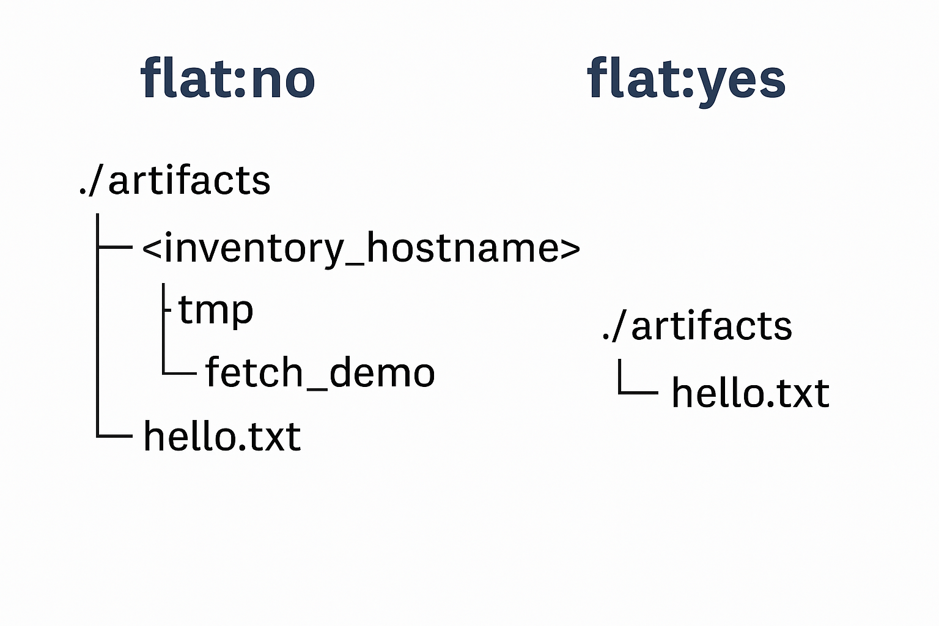
Explanation flat: yes, vs flat: no
Explanation
flat: no (Default Behavior)
Creates a directory structure that mirrors the remote path under the destination folder. Also adds a subfolder named after the inventory hostname. This prevents filename collisions when fetching from multiple hosts.
Example:
fetch:
src: /tmp/fetch_demo/hello.txt
dest: ./artifacts/flat_no/
flat: no
Result on control node:
./artifacts/flat_no/<inventory_hostname>/tmp/fetch_demo/hello.txt
✔ Good for multi-host scenarios because each host’s files are kept separate and organized.
flat: yes
Places the file directly in the destination directory without creating subfolders. No remote path structure is preserved. Risk: If multiple hosts have files with the same name, later hosts overwrite earlier ones.
Example:
fetch:
src: /tmp/fetch_demo/hello.txt
dest: ./artifacts/flat_yes/
flat: yes
Result on control node:
./artifacts/flat_yes/hello.txt

Slide 9
Fetch Module Lab
Example Code
---
- name: Demo for Ansible 'fetch' module
hosts: target
become: yes
gather_facts: no
vars:
# Where we will create a simple file on remote hosts
remote_dir: /tmp/fetch_demo
remote_file: "{{ remote_dir }}/hello.txt"
# Where files will be saved on the control node
dest_root: "./artifacts/fetch_demo"
tasks:
- name: Ensure remote demo directory exists
file:
path: "{{ remote_dir }}"
state: directory
mode: '0755'
- name: Create a demo file on the remote host
copy:
dest: "{{ remote_file }}"
content: |
Hello from {{ inventory_hostname }}!
This file was created to demonstrate the fetch module.
Timestamp: {{ lookup( 'pipe', "date '+%Y-%m-%d %H:%M:%S'") }}
- name: Fetch the demo file (organized by host) where flat is no
fetch:
src: "{{ remote_file }}"
dest: "{{ dest_root }}/flat_no/"
flat: no # Default: creates per-host subfolder
validate_checksum: yes # Verifies file integrity
- name: Fetch the demo file (single folder) where flat is yes
fetch:
src: "{{ remote_file }}"
dest: "{{ dest_root }}/flat_yes/"
flat: yes # Places file directly under dest
validate_checksum: yes
- name: Try fetching a missing file (to show fail_on_missing behavior)
fetch:
src: "{{ remote_dir }}/missing.txt"
dest: "{{ dest_root }}/missing_test/"
flat: yes
fail_on_missing: no # Play will continue even if file is missing

Slide 10
Real-World Use Cases
Slurp: Read configuration files (e.g., /etc/hosts, /etc/nginx/nginx.conf) from remote servers and validate their content before making changes.
Blockinfile: Insert compliance headers in config files
Fetch: Collect audit logs from multiple servers for security review

Slide 11
Quiz
Q1) What does Slurp module return? A) Plain text B) Base64 encoded data C) JSON D) YAML
Q2) Which parameter in fetch prevents overwriting files? A) flat B) validate_checksum C) fail_on_missing D) dest
Q3) Why is blockinfile better than lineinfile for multi-line updates? A) Faster execution B) Adds markers and manages blocks C) Works only on Windows D) Requires no sudo
Q4) Which option in fetch organizes files per host? A) flat: yes B) flat: no C) validate_checksum D) backup

Slide 12
Lab Exercises
1. Slurp Module Lab: Create and deploy Nginx config using Jinja2
2. Blockinfile Lab: Add a custom block to /etc/hosts
3. Fetch Lab: Retrieve /etc/hosts from all servers and store locally

Slide 13

Subscibe to AutomateOps!
✔ Learn IT Automation with Ansible ✔ Like, Share & Subscribe for more DevOps content Follow us: https://youtube.com/@soumyendupal?si=wm1qKm5F51XyF04t

